Slide 1

Page Replacement
PASS
CS532: OS Foundations
Lab Assignment
Mail id: faiyaz@pdx.edu
Partner’s mail id: boyapati@pdx.edu

Slide 2
Instructions: Make a copy of this document, move your copy to your submissions folder and fill the document with your responses. Use the space on each slide to show your responses, and add additional slides as needed.
When ready for grading: complete the lab assignment submission form and include a link to your filled document

Slide 3
paging-policy.py
Find the paging-policy.py program within the vm-beyondphys-policy sub-directory of your ostep-homework directory. Use paging-policy.py to experiment with various page-replacement policies.
Read the README.md file in the sub-directory and run the program with the --help switch to learn more about this simulator’s features.

Slide 4
1. Use paging-policy.py to generate random address traces using the following command line arguments. The program also simulates a page replacement policy such as FIFO, LRU and OPT. Fill the following table with number of page misses for each scenario :
(first, run without the -c option and calculate #misses yourself. then use -c to check your work)
Good
 | FIFO | LRU | OPT
-s 0 -n 15 | 13 | 12 | 10
-s 1 -n 15 | 12 | 12 | 8
-s 2 -n 15 | 11 | 11 | 9

Slide 5
2. For a cache of size 5, create worst-case address reference streams for each of the following policies: FIFO, LRU, and MRU (worst-case reference streams cause the most misses possible.
For FIFO and LRU:
python3 paging-policy.py --addresses=3,4,5,6,7,8,3,4,5,6,7,8 --policy=FIFO --cachesize=5 -c
python3 paging-policy.py --addresses=3,4,5,6,7,8,3,4,5,6,7,8 --policy=LRU --cachesize=5 -c
For MRU:
python3 paging-policy.py --addresses=3,4,5,6,7,8,7,8,7,8,7,8 --policy=MRU --cachesize=5 -c
For the worst case reference streams, how much bigger of a cache is needed to improve performance dramatically and approach OPT?
Answer: One
Good

Slide 6
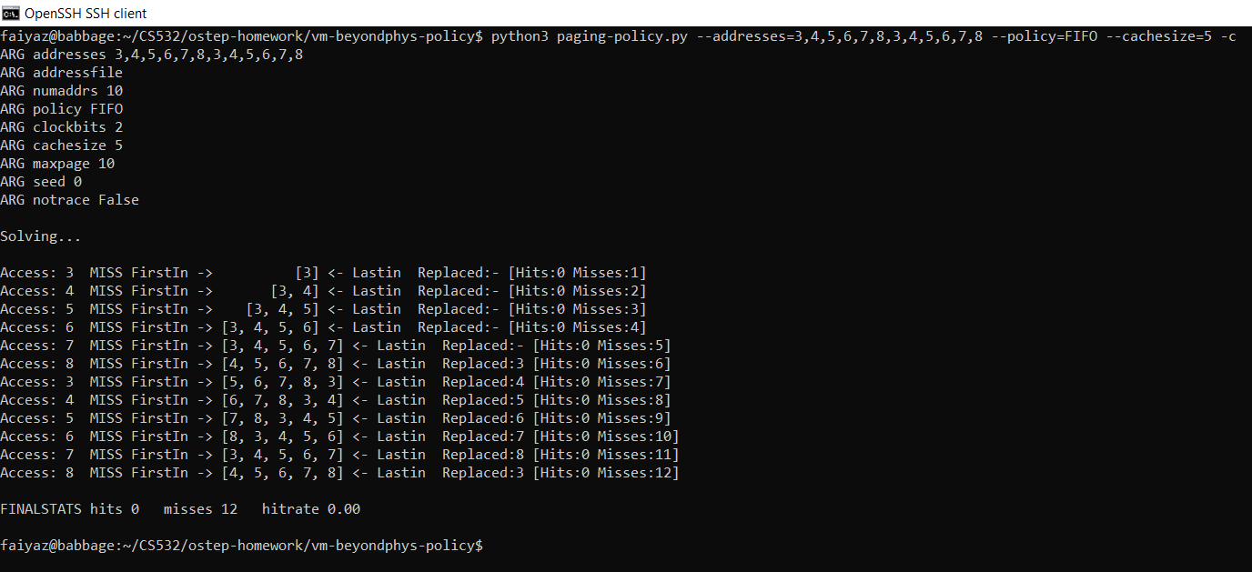
python3 paging-policy.py --addresses=3,4,5,6,7,8,3,4,5,6,7,8 --policy=FIFO --cachesize=5 -c

Slide 7
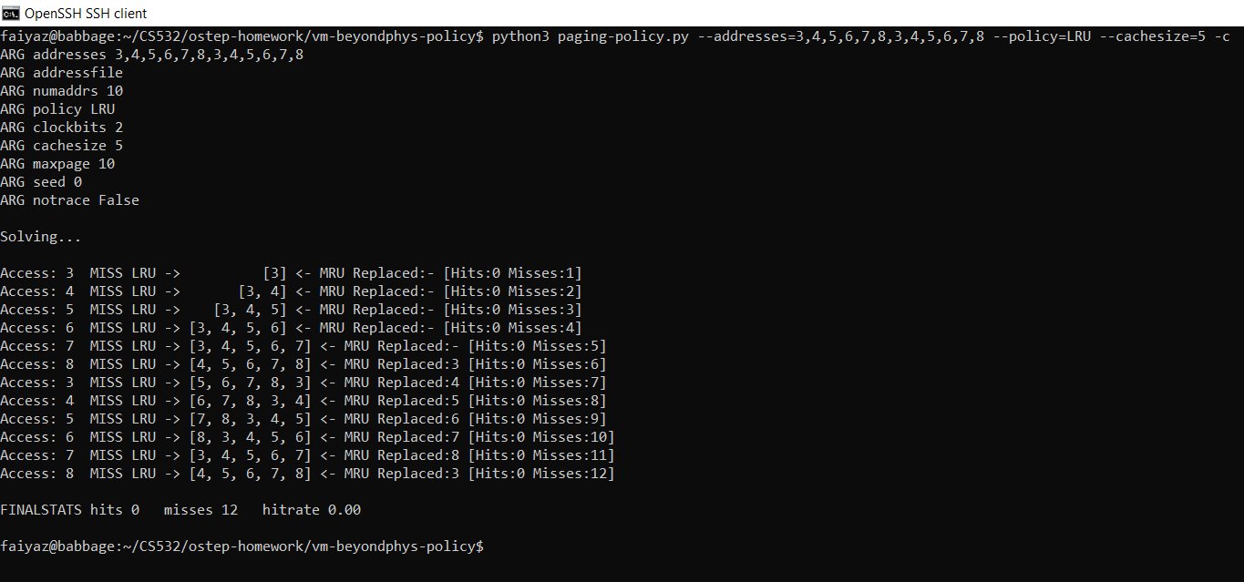
python3 paging-policy.py --addresses=3,4,5,6,7,8,3,4,5,6,7,8 --policy=LRU --cachesize=5 -c

Slide 8
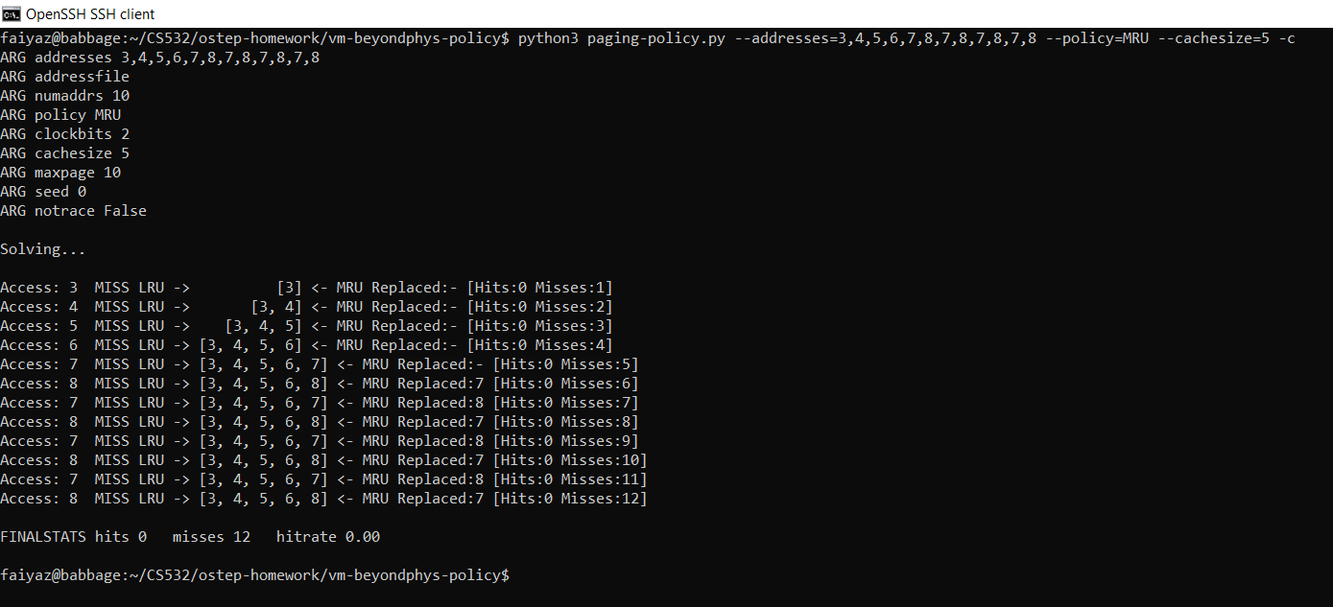
python3 paging-policy.py --addresses=3,4,5,6,7,8,7,8,7,8,7,8 --policy=MRU --cachesize=5 -c

Slide 9
Good
3. Generate random traces using the following settings.
 | FIFO | RAND | LRU | OPT
-a -1 -n 1000 -m 50 -s 10 -C 10 -c | 804 | 818 | 808 | 522
-a -1 -n 1000 -m 50 -s 20 -C 10 -c | 798 | 803 | 795 | 513
-a -1 -n 1000 -m 50 -s 30 -C 10 -c | 789 | 789 | 784 | 513
3A. Fill in the cells with the number of misses for each policy. Use the -c switch for these computations.

Slide 10
Good
3B. What do you observe about the relative performance of the three algorithms for this -m 50 -C 10 scenario?
Answer: From the above table, we can see that OPT is most optimal page replacement algorithm. The test three(LRU, FIFO and RAND) have a similar performance.

Slide 11
Good
3B. Next, vary -m and -C systematically and observe the change in performance of the four algorithms as you vary the scenarios. What can you conclude about the relative performance of the four algorithms over the range of scenarios that you observed?
Answer: By systematically varying the values of -m and -c for the four algorithms, we can observe that OPT performs the best. The next in the row are LRU, RAND and the FIFO respectively. When we increase -m, then max page number, which decreases the hit rate. When we increase the -c, we can see that hit rate increases because of bigger cache size.

Slide 12
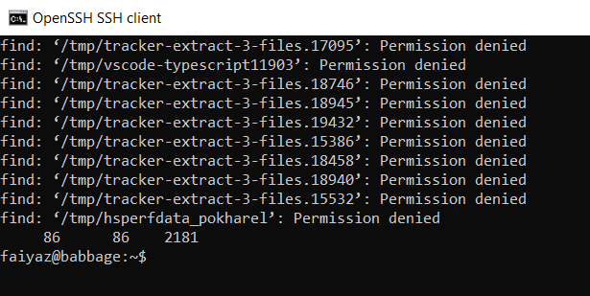
4. On babbage.cs.pdx.edu, find the files contained in the /tmp directory (and all sub-directories).
Do it like this: find /tmp -type f
4A. How many files are in your system’s /tmp directory (and sub-directories)? One easy way to do this is to pipe the output of the find command through the wc program, like this: find /tmp -type f | wc
Answer: 86 files
Looks good now

Slide 13

4B. Next, create a detailed memory trace of your find command using the valgrind utility.
Like this: valgrind --tool=lackey --trace-mem=yes find /tmp/ -type f
This generates MANY output lines on the stderr channel. To capture stderr output use 2> on the command line. So the whole thing would look like this:
valgrind --tool=lackey --trace-mem=yes find /tmp/ -type f 2> mytrace.out
How large is your trace (how many text lines in the trace file)?
Answer: 7508498
Good

Slide 14
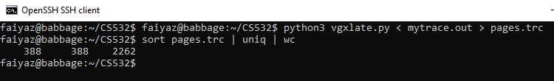
4C. Next, convert your valgrind trace to a format that can be analyzed by the paging-policy.py program. We created a python utility called vgxlate.py for this purpose. Find/download vgxlate.py linked from the Virtualization course plan page on our class website and move it to your linux system.
Run it like this: python vgxlate.py < mytrace.out > pages.trc
How many unique pages were referenced by your find? To calculate the number of unique pages, sort the translated trace file, eliminate duplicate lines and then count the lines. Like this: sort pages.trc | uniq | wc
Answer: 388 unique pages are referenced.
Looks good now

Slide 15
4D. How do the various page replacement algorithms work for your real trace? Run paging-policy.py -f pages.trc ... to analyze your trace. Here is an example that simulates the CLOCK algorithm with pages.trc:
python3 ./paging-policy.py -f pages.trc -p CLOCK -b 2 -N -c -C 3
How large of a page cache do you need in order to achieve a hit ratio of 98%?
Answer this question for RAND, LRU, FIFO and CLOCK (with -b 2). Does the page cache size change significantly for these four algorithms.
Answer:
RAND - 25
FIFO - 23
CLOCK - 20
LRU - 18
Yes the page cache size changes significantly for these four algorithms.
Good

Slide 16
4E. Note that we did not ask you compute the 98% ratio cache size for the OPT algorithm. Why do you suppose we skipped that one?
Answer: Since it is a real time query and we could never know what the future page requests would look like which is very much on what the OPT algorithm is based off.
good observation/explanation. But this is a trace, so we know all of the future page references. Yet we did not ask you to simulate OPT for this trace. Why?
The reason we did not ask you to simulate OPT is because the OPT algorithm takes a long time to find the last known reference for every page in the simulated page cache. To observe this try to run with the OPT policy with your trace. It will seem to hang because it is working so hard to run its expensive, O(n*n) simulation of the OPT algorithm. On a trace containing millions of records the simulator will need hours or days to complete. While running the simulator in one window, open a second window, run the “htop” command and observe that python and the paging-policy.py script is utilizing enormous amounts of CPU time.

Slide 17
4F. Share your observations about the relative performance of LRU, FIFO, RAND and CLOCK for your real program page trace.
Answer: While we know that for the page size, below results are obtained:-
RAND - 25
FIFO - 23
CLOCK - 20
LRU - 18
From the above we can say that, RAND requires the highest size for achieving the 98% hit ratio and it has the worst performance.
OK

